Slide 1
CS2005 Database System
Saba Ghani
FAST-NU
Chiniot-Faisalabad campus

Slide 2
Lecture 1.2
Introduction to data and information
File management system
Database
Properties of database
Database Management system
Advantages of Database system

Slide 3
Introduction to Data and Information
Data: Raw facts and figures Example: the numbers 10.5, 22, and 119 are data
Information Process form of data that is meaningful

Slide 4
Introduction to Data and Information
Information: Data Processed to reveal its meaning
Information is meaningful
In today’s world, accurate, relevant and timely information is the key to good decision making
Good decision making is key to survival in today’s competitive and global environment
Example: The temperature of room 119 in building 22 is 10.5, is an information

Slide 5
Data, information and knowledge
Knowledge: is something which is derived or inferred from available information using some level of intelligence.
Example: Based on experience, the above information can be used to infer that the room is quite cold and could cause some inconvenience if we work in that room for a long period of time with out wearing worm clothes.

Slide 6
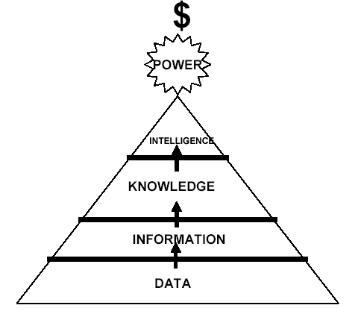
Data, information and knowledge

Slide 7
Database
Databases and database technology have had a major impact on the growing use of computers.
Database Play a critical role in almost all areas where computers are used, including business, electronic commerce, social media, engineering, medicine, genetics, law, education, and library science

Slide 8
Database
Collection of logically interrelated data that can be shared
By data, we mean known facts that can be recorded and that have implicit meaning.
For example, consider the names, telephone numbers, and addresses of the people you know.
Notes:
Databases and database technology have had a major impact on the growing use of computers.

Slide 9
Database
Def 1: Database is an organized collection of logically related data
Def 2: A database is a shared collection of logically related data that is stored to meet the requirements of different users of an organization
Def 3: A database is a self-describing collection of integrated records
Def 4: A database models a particular real world system in the computer in the form of data

Slide 10
Properties of Database
A database has the 3 implicit properties:
A database represents some aspect of the real world, sometimes called the miniworld or the universe of discourse (UoD). Changes to the miniworld are reflected in the database.
A database is a logically coherent collection of data with some inherent meaning. A random assortment of data cannot correctly be referred to as a database.
A database is designed, built, and populated with data for a specific purpose. It has an intended group of users and some preconceived applications in which these users are interested.
Notes:
1. Aspects of real world, 2. inherent meaning, 3. purpose and users

Slide 11
Why we need Database?
Older/legacy system uses simple file system to stored data These system have an issue of
Data Redundancy
Data inconsistency
Data integrity issue
Security and protection
Data Retrieval
And Many more……

Slide 12
Database Management System (DBMS)
A database management system (DBMS) is a computerized system that enables users to create and maintain a database.
The DBMS is a general-purpose software system that facilitates the processes of defining, constructing, manipulating, and sharing databases among various users and applications
Notes:
Define (metadata),

Slide 13
Database Management System (DBMS)
Defining a database involves specifying the data types, structures, and constraints of the data to be stored in the database. The database definition or descriptive information is also stored by the DBMS in the form of a database catalog or dictionary; it is called meta-data.
Constructing the database is the process of storing the data on some storage medium that is controlled by the DBMS.
Manipulating a database includes functions such as querying the database to retrieve specific data, updating the database to reflect changes in the miniworld, and generating reports from the data.
Sharing a database allows multiple users and programs to access the database simultaneously.

Slide 14

Example
UNIVERSITY database for maintaining information concerning students, courses, and grades in a university environment
Define: file (records), data elements, data type ( for each data element)
Construct: store data in the appropriate files (note that records may be related between files)
Manipulation: querying, updating
informal queries and updates must be specified precisely in the database system language before they can be processed.
Sharing: Users from different departments can share same files

Slide 15
DBMS’s Example
Oracle
IBM DB2
Ingress
Teradata
MS SQL Server
MS Access
MySQL etc.

Slide 16
Functions of DBMS
Access & Process:
An application program accesses the database by sending queries or requests for data to the DBMS. A query typically causes some data to be retrieved; a transaction may cause some data to be read and some data to be written into the database.
Protection:
includes protecting the database and maintaining it over a long period of time. Protection includes system protection against hardware or software malfunction (or crashes) and security protection against unauthorized or malicious access.

Slide 17
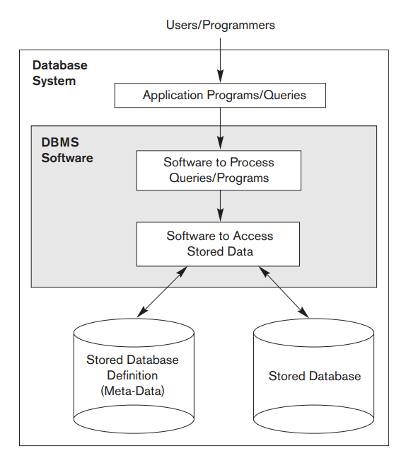
Functions of DBMS

Slide 18
Characteristics of the Database Approach
Self-describing nature of a database system
Insulation between programs and data, and data abstraction
Support of multiple views of the data
Sharing of data and multiuser transaction processing

Slide 19
1. Self-Describing Nature of a Database System
single repository of data is maintained
Repository is a structure that stores metadata. It is used to control database operations, integrity and accuracy.
contains not only the database itself but also a complete definition or description of the database structure and constraints (system catalogue).
information stored in the catalog is called meta-data
catalog used by the DBMS and users.
The DBMS software work equally well with any number of database applications.

Slide 20
Meta Data
Meta Data
Data about data OR
Data that describe the properties or characteristics of end-user data and the context of those data.
metadata contains data item name, the data type, length, minimum and maximum allowable values (where appropriate), a brief description of each data item, and the source of the data.
Meta Data is store in a file called repository, data dictionary or catalog.

Slide 21
2. Insulation between Programs and Data, and Data Abstraction
In traditional file system , the program and data are dependent on each others.
Changes in data causes to change whole program/ structure
But In DBMS the program and data are independent. Change in data does not causes to change the whole program.
This concepts is known as data abstraction
The data abstraction is achieved through transparency by separating the user level from conceptual level

Slide 22
2. Insulation between Programs and Data, and Data Abstraction
In database system, users can define operations on data as part of the database definitions.
An operation (also called a function or method) is specified in two parts.
User level operation: The interface (or signature) of an operation includes the operation name and the data types of its arguments (or parameters).
Conceptual Level: The implementation (or method) of the operation is specified separately and can be changed without affecting the interface.

Slide 23
3. Support of Multiple Views of the Data
A database typically has many types of users, each of whom may require a different perspective or view of the database.
A database view is a subset of a database and is based on a query that runs on one or more database tables.

Slide 24
3. Support of Multiple Views of the Data
A view may be a subset of the database, or it may contain virtual data (derived from the database files but is not explicitly stored).
A multiuser DBMS whose users have a variety of distinct applications must provide facilities for defining multiple views
Examples: Flex, Facebook view etc

Slide 25
4. Sharing of Data and Multiuser Transaction Processing
In multiusers database system, multiple user can access same/different content
To ensure integrity, the database must include concurrency control mechanism and different type of constraints to ensure correct execution of program and maintain correct state of database.

Slide 26
Advantages of DBS
Controlling Redundancy
Problems:
University System
Student Registration
Fee department
Library

Slide 27
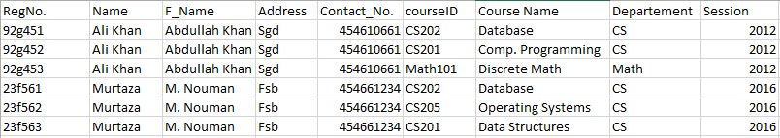
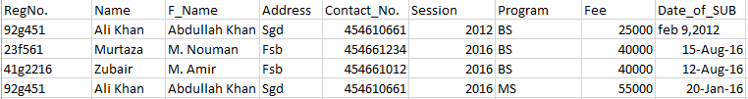
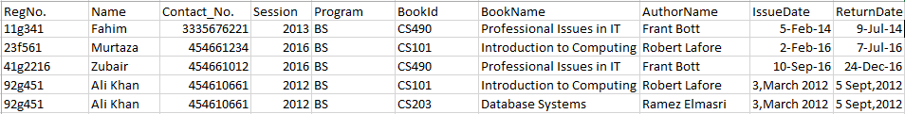
Advantages of DBS
Registration
Fee
Library

Slide 28
Advantages of DBS
Controlling Redundancy
Reduce data inconsistency
Restricting Unauthorized Access
Providing Multiple User Interfaces
Representing Complex Relationships Among Data
Enforcing Integrity Constraints
Providing Backup and Recovery

Slide 29
Advantages of DBS
Reduce data inconsistency
Data is not duplicated so need to apply only single update.
This causes consistent data.
As no row is duplicated so record of each instance is consistent and accurate.

Slide 30
Advantages of DBS
Restricting Unauthorized Access
users or user groups are given account numbers protected by passwords, which they can use to gain access to the database through security and authorization subsystem
Providing Multiple User Interfaces
a DBMS provides a variety of user interfaces: query languages for casual users; programming language interfaces for application programmers; forms and command codes for parametric users; and menu-driven interfaces and natural language interfaces for stand-alone users.
Capabilities for providing World Wide Web access to a database

Slide 31
Advantages of DBS
Representing Complex Relationships Among Data
Enforcing Integrity Constraints
Data integrity refers to correctness and accuracy of data
The simplest type involves specifying a data type for each data item
A more complex type involves specifying that a record in one file must be related to records in other files.
Another type specifies uniqueness on data item values
It is the database designers’ responsibility to identify integrity constraints during database design.
Providing Backup and Recovery
provide facilities for recovering from hardware or software failures.(The backup and recovery subsystem )

Slide 32
Are there any DISADVANTAGES of DBMS?

